Slide 1

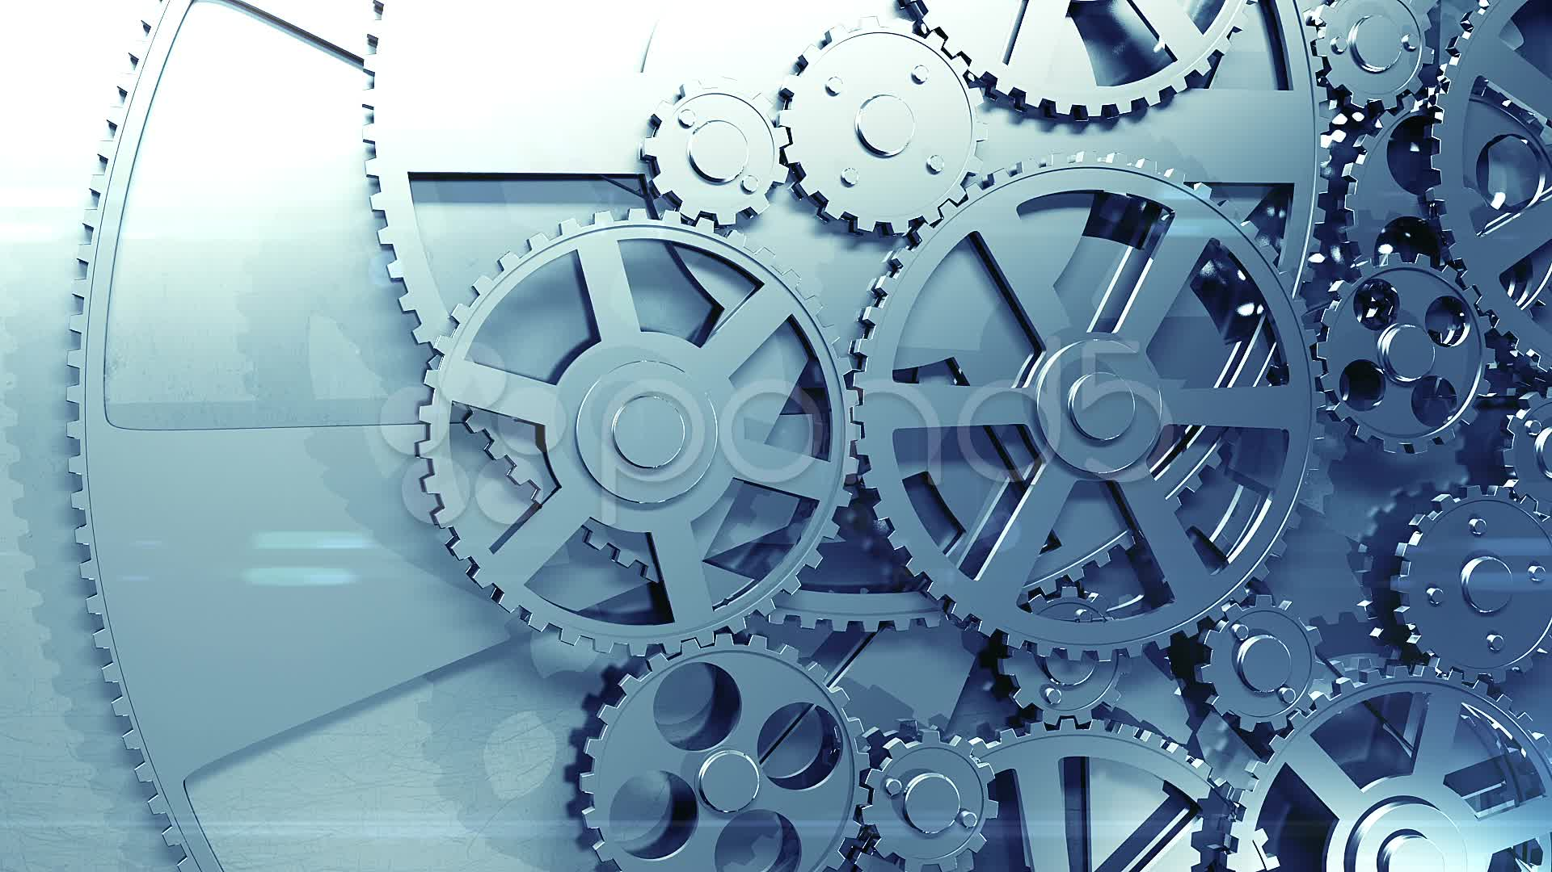
ME2115/ME2115E/TME2115 - Mechanics of Machines
Mass properties
Dr. SHEN Lei (Part I)
Email: shenlei@nus.edu.sg
Tel: 66013813; Office: EA-05-09

Slide 2
Contents
Mass properties
Objective: To study mass related properties of a thin plate
Mass centre
Centre of gravity (CG)
Centroid of an area (CA)
First moment of an area (for locating CA)
Composite Plates and Areas
Mass moment of inertia (I)
Second moment of mass (for determining I)
Parallel-axis theorem

Slide 3



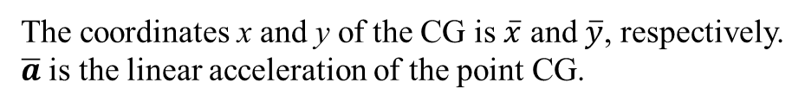




Introduction to mass centre and CG
The earth exerts a gravitational force on each of the particles forming a body. These forces can be replace by a single equivalent force equal to the weight of the body and applied at the mass centre for the body, which is called centre of gravity (CG) because of a uniform gravitational field on earth.
New notation: an overline to represent CG
such as,
$$\overline{x}=x_{G}$$
$$\overline{I}=I_{G}$$
$${\overline{a}}_{x}={{(a}_{G})}_{x}$$
$$⋯⋯$$
$$\overline{y}=y_{G}$$
$$\overline{a}=a_{G}$$
$${\overline{a}}_{t}={{(a}_{G})}_{t}$$
The coordinates x and y of the CG is $\overline{x}$ and $\overline{y}$, respectively.
$\overline{a}$ is the linear acceleration of the point CG.
Notes:
A bar or line over the top of a letter

Slide 4
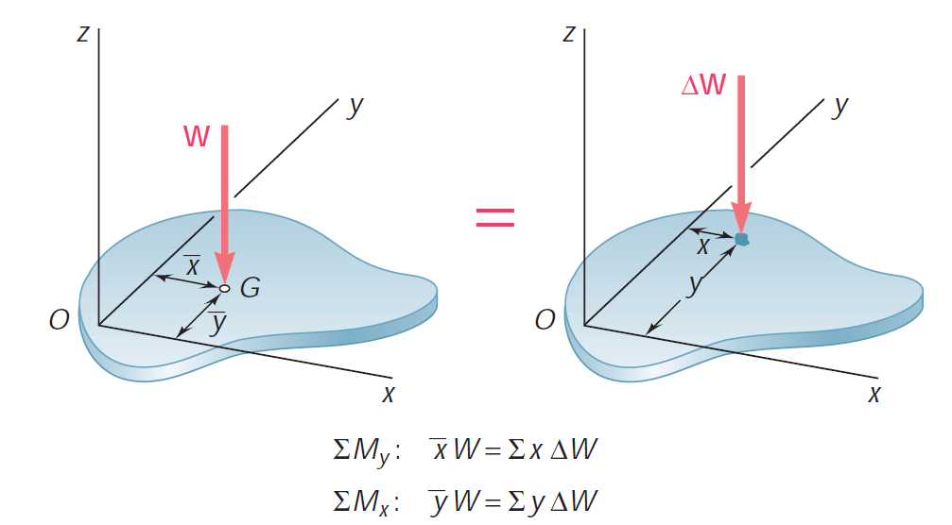
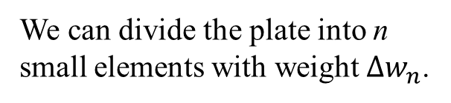




Centre of Gravity of a plate
We can divide the plate into n small elements with weight $∆w_{n}$.
$$n$$
$$n$$
$$n$$
Moment about y
Moment about x
$$n$$
$$n$$
$$n$$
$$n$$
$$n$$
Formulas for locating CG

Slide 5
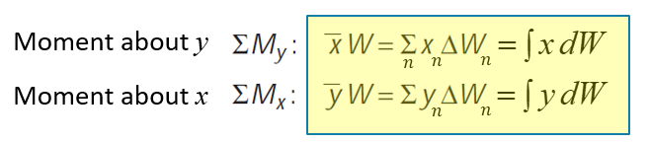
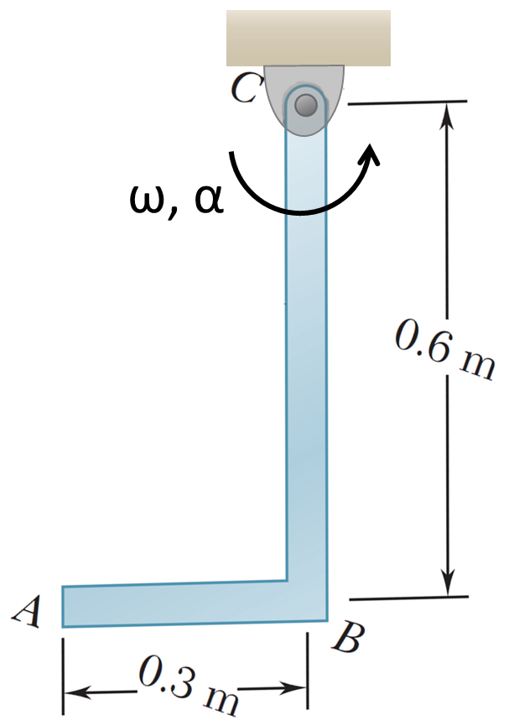
2021 exam
QUESTION 2
The right-angle object ABC of two slender rods welded together at point B. Rod AB has a mass of 1 kg and bar BC has a mass of 2 kg.
Q: locate CG
y
x

Slide 6
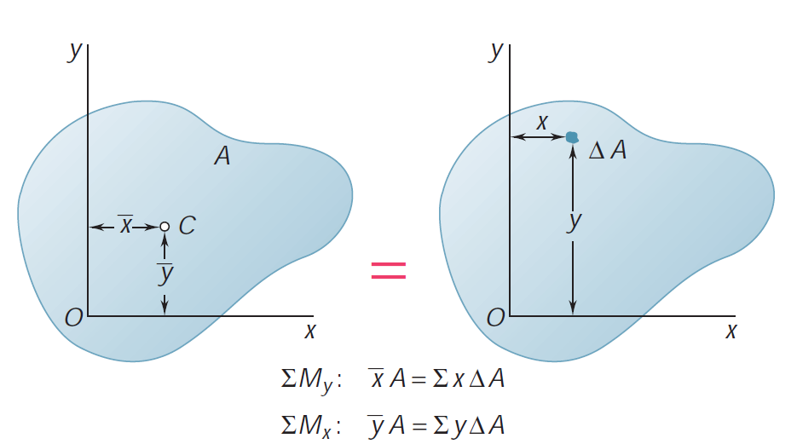
*Centroids of an area & First Moments of Areas
The centroid of an area (CA) is analogous to CG of a body. The concept of the first moment of an area is used to locate the point of CA.
In the case of a flat homogeneous plate of uniform thickness, the magnitude ΔW of the weight of an element of the plate can be expressed as
where γ is specific weight (weight per unit volume), t the thickness, and dA the area of the element.
These equations also define the coordinates x and y of CG of a homogeneous/uniform plate !!!
The other way for locating CG
Notes:
First order of moment of area, in short first moment of area

Slide 7
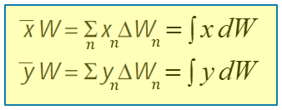

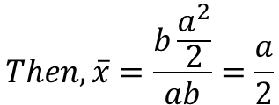

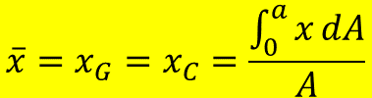
Example 1
Uniform thickness
Non-uniform thickness
.
t₀
.
G
.
b
C &
C
G
a
Locate the CG of a thin homogenous plate shown.
Solution:
y
dx
D
E
Method 1: using the formulae
$$\overline{x}=x_{G}=x_{C}=\frac{\int_{0}^{a}{x}dA}{A}$$
x
b
$$where, A=ab;dA=bdx$$
O
F
a
x
$$Then,\overline{x}=\frac{b\frac{a^{2}}{2}}{ab}=\frac{a}{2}$$
Method 2: find CA first using 1st moment of area
The centroid of rectangular area, C, can be located by:
$$Similarly,\overline{y}=\frac{b}{2}$$
Thus, the location of CG is at a/2 and b/2 with respect to OD and OF, respectively.
If the plate is homogeneous with uniform thickness, the centroid of the area, C, coincides with the centre of gravity, G. Otherwise, not.

Slide 8
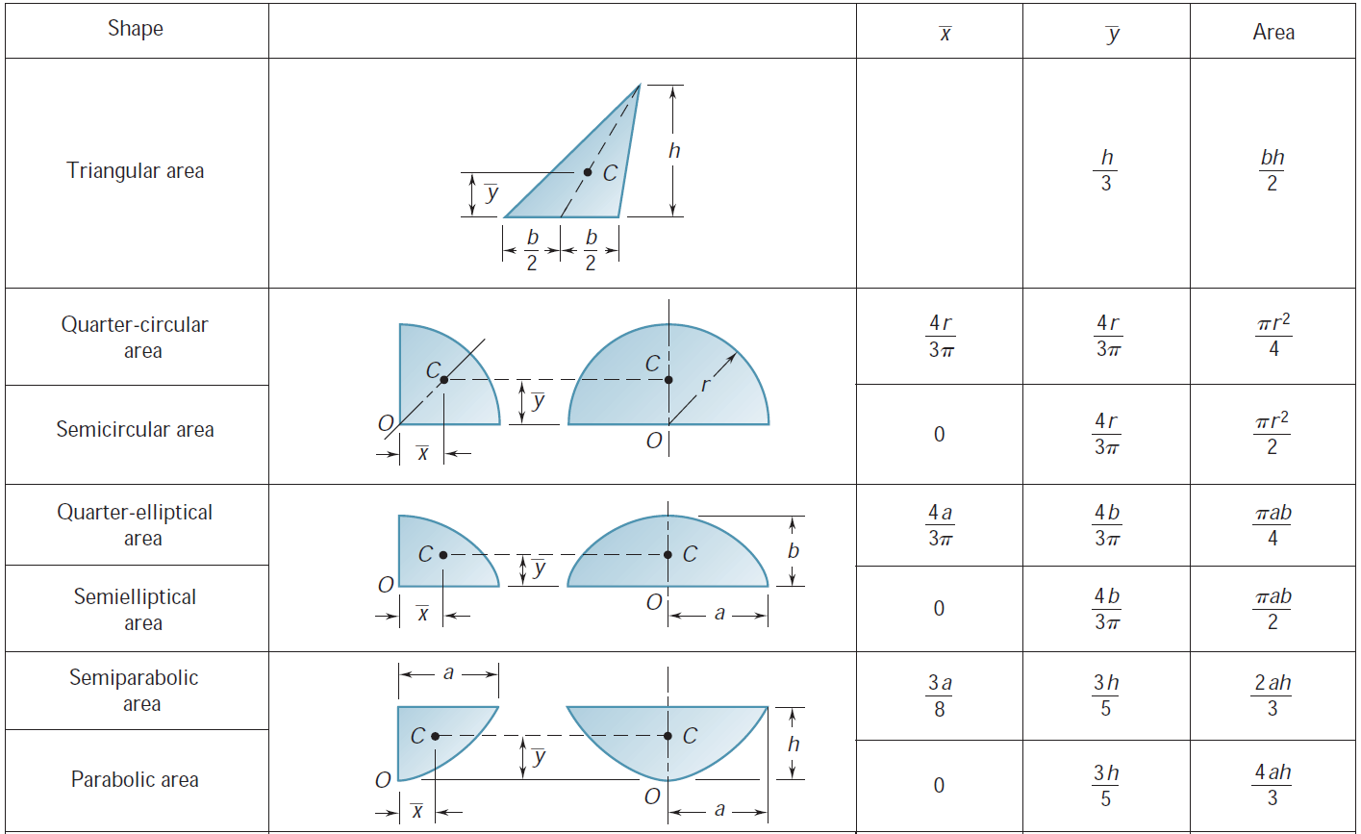
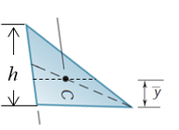
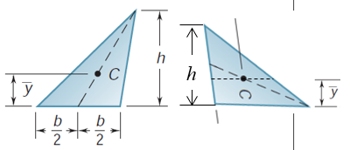
Centroids of Common Shapes of Areas
Notes:
Besides the centroid of a rectangle, you may find the centroids of common shapes of areas in this table.
No x-bar, because it is the same to y-bar. If you rotate the triangle, the intersection is the centroid of the triangular area.
X-bar is zero for a semicircle because of its mirror symmetry. The centroid must be on the line of the symmetry. That’s why x-bar is zero.

Slide 9
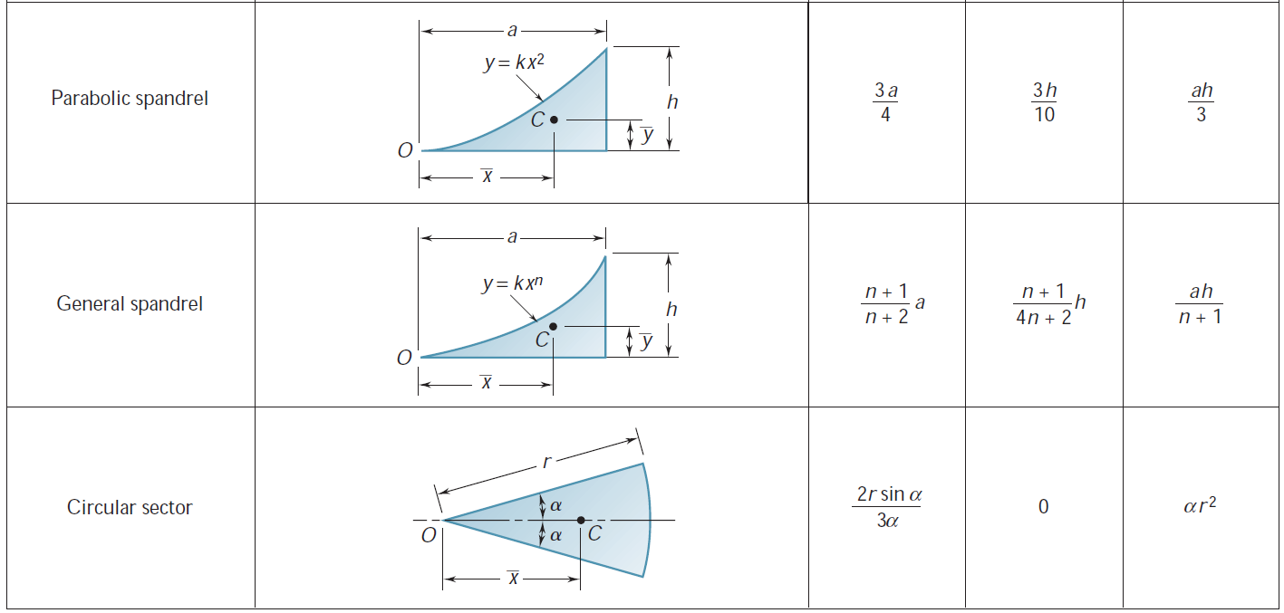
Centroids of Common Shapes of Areas

Slide 10
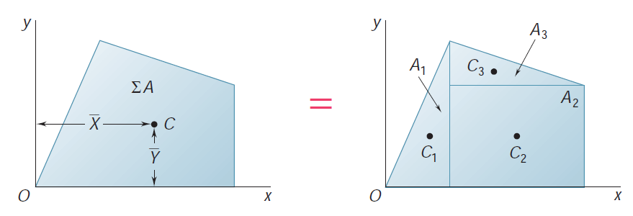
*Composite Areas
Tip: divide the composite area into several regular areas

Slide 11
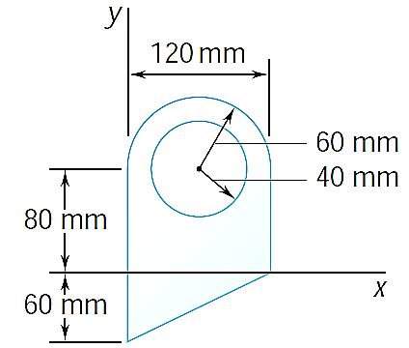
Example 2
SOLUTION:
Divide the area into a triangle, rectangle, and semicircle with a circular cutout.
Calculate the first moments of each area with respect to the axes.
Find the total area and first moments of the triangle, rectangle, and semicircle. Subtract the area and first moment of the circular cutout.
For the plane area shown, determine the first moments with respect to the x and y axes and the location of the centroid.
Compute the coordinates of the area centroid by dividing the first moments by the total area.

Slide 12
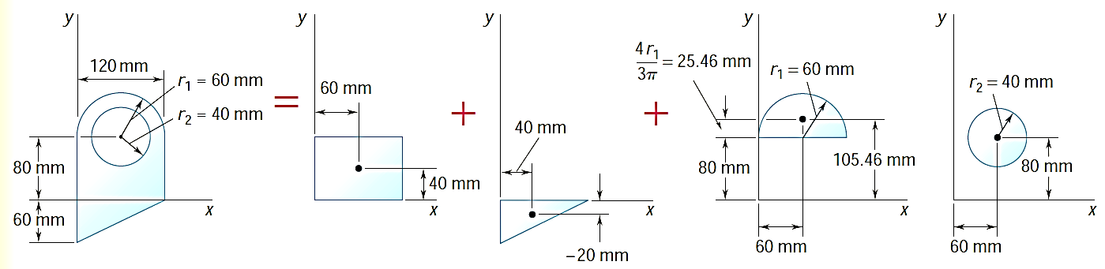
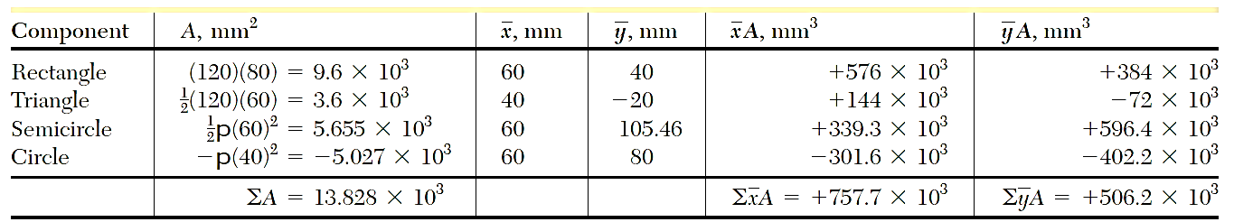

Example 2 (solution)
$$\frac{h}{3}$$
_
cutout
Q_{y}
Q_{x}
Fix the position of each part with respect to the same coordinates.
Find the total area and first moments of the triangle, rectangle, and semicircle.
Subtract the area and first moment of the circular cutout.

Slide 13
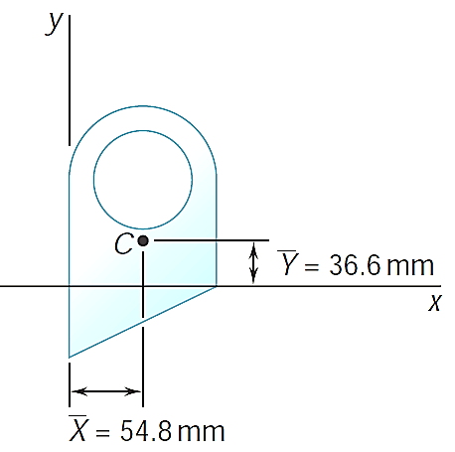
Example 2 (solution)
Compute the coordinates of the area centroid by dividing the first moments by the total area.

Slide 14
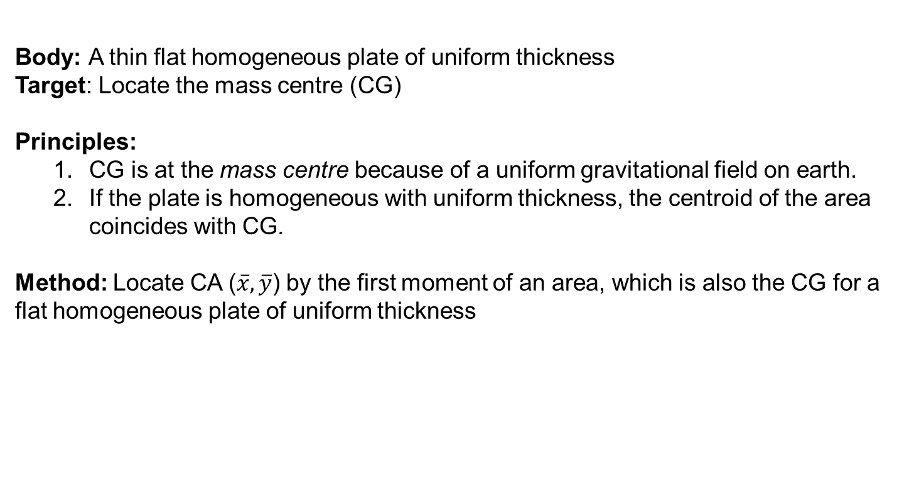
*Summary of mass centre
Body: A thin flat homogeneous plate of uniform thickness
Target: Locate the mass centre (CG)
Principles:
CG is at the mass centre because of a uniform gravitational field on earth.
If the plate is homogeneous with uniform thickness, the centroid of the area coincides with CG.
Method: Locate CA ($\overline{x},\overline{y}$) by the first moment of an area, which is also the CG for a flat homogeneous plate of uniform thickness
Composite area: divide the composite area into several regular areas.

Slide 15
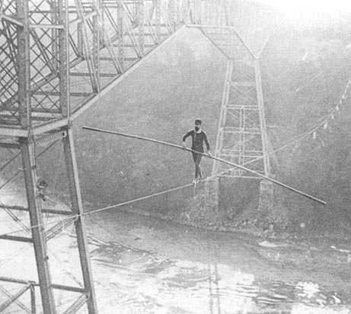
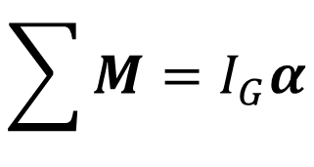
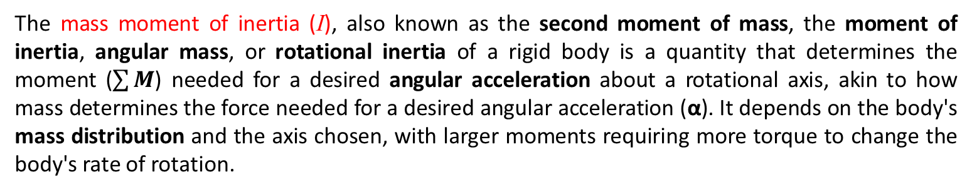
Mass moment of inertia (I): Definition
The mass moment of inertia (I), also known as the second moment of mass, the moment of inertia, angular mass, or rotational inertia of a rigid body is a quantity that determines the moment ($\sum{M}$) needed for a desired angular acceleration about a rotational axis, akin to how mass determines the force needed for a desired angular acceleration (α). It depends on the body's mass distribution and the axis chosen, with larger moments requiring more torque to change the body's rate of rotation.
$$\sum{M}=I_{G}α$$
* See proof in next Chapter “kinetics of rigid bodies”
Tightrope walkers use the mass moment of inertia of a long rod for balance as they walk on the rope.
Notes:
It is a’nalogous to sumF=ma
Larger I, smaller alpha; small rotation => good balance

Slide 16
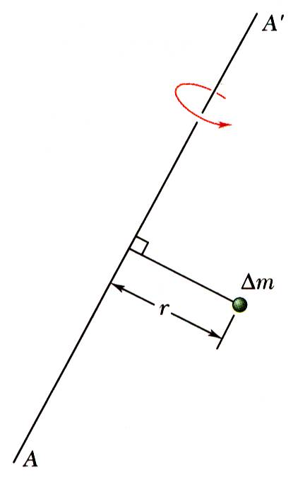
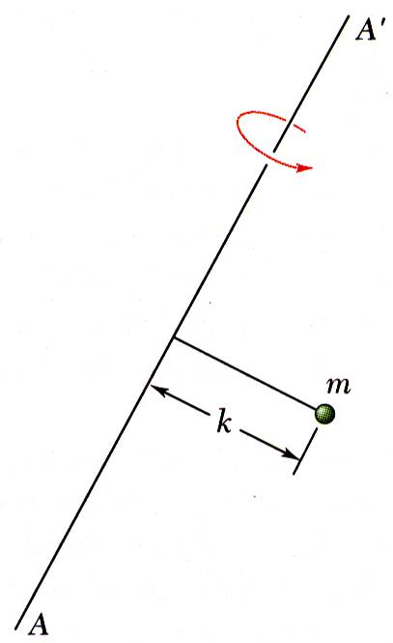
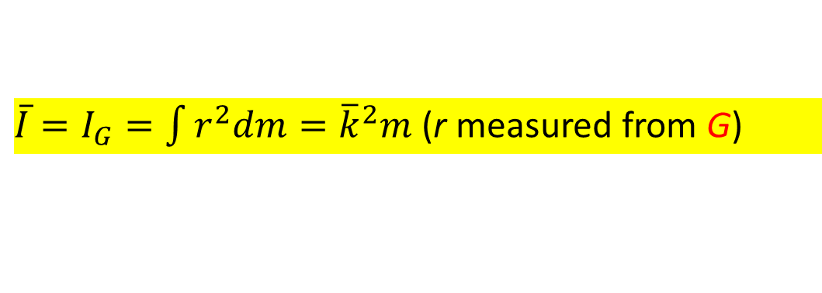
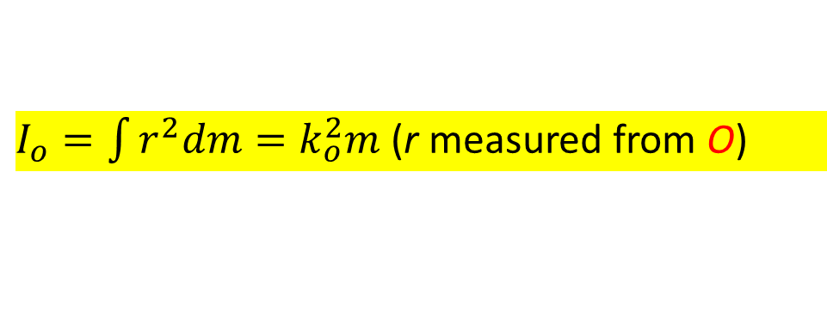

*Mass moment of inertia (I): Formula
Considering plane motion ONLY,
The general definition for I with respect to the perpendicular axis through point O (not necessarily through CG) is
G
dm
O
r
$I_{o}=\int{r^{2}dm=k_{o}^{2}m}$ (r measured from O)
k_{o} is the radius of gyration for an equivalent concentrated point mass of the rigid body)
O
$$=$$
O
The radius of gyration k represents, therefore, the distance at which the entire mass of the body should be concentrated if its moment of inertia with respect to AA’ is to remain unchanged.
If the reference point is the mass centre G, we use the notation $\overline{I}$, i.e., the mass moment of inertia about the centroidal axis is
${\overline{I}=I}_{G}=\int{r^{2}dm={\overline{k}}^{2}m}$ (r measured from G)
Notes:
If k is given directly, it is simple to get I_G. If not, we have to solve the integral to obtain I_G.

Slide 17
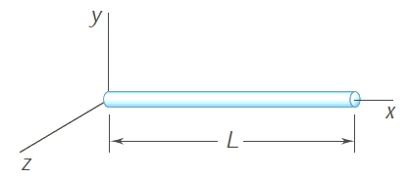
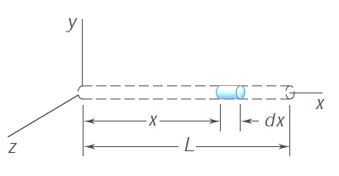
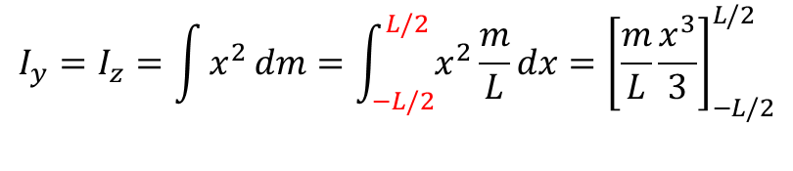


Example 3
Determine the mass moment of inertia of a slender rod of length L and mass m with respect to an axis which is perpendicular to the rod and passes through the midpoint O of the rod.
Y
Solution:
For a slender rod, its cross-section is negligible compared with its length. Instead of the volume density (mass/volume), we take the length density (mass/length) for the one-dimensional slender rod.
Choosing the differential element of mass shown, we write
Z
Y
$$dm=length density∗length=\frac{m}{L}dx$$
x
$$I_{y}=I_{z}=\int{x^{2}}dm=\int_{−L/2}^{L/2}{x^{2}}\frac{m}{L}dx={\left[\frac{m}{L}\frac{x^{3}}{3}\right]}_{−L/2}^{L/2}$$
Z
$$I_{y}=I_{z}=\frac{1}{12}mL^{2}$$

Slide 18
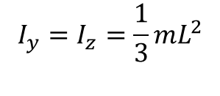
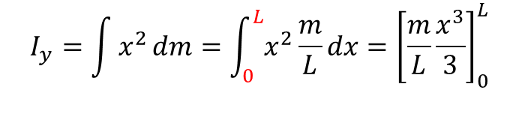
Example 4
Determine the mass moment of inertia of a slender rod of length L and mass m with respect to an axis which is perpendicular to the rod and passes through one end of the rod.
Solution:
Again, we write
$$I_{y}=\int{x^{2}}dm=\int_{0}^{L}{x^{2}}\frac{m}{L}dx={\left[\frac{m}{L}\frac{x^{3}}{3}\right]}_{0}^{L}$$
Notice that we now take the end as origin O, resulting the change of range of integral from 0 to L.
$$I_{y}=I_{z}=\frac{1}{3}mL^{2}$$

Slide 19
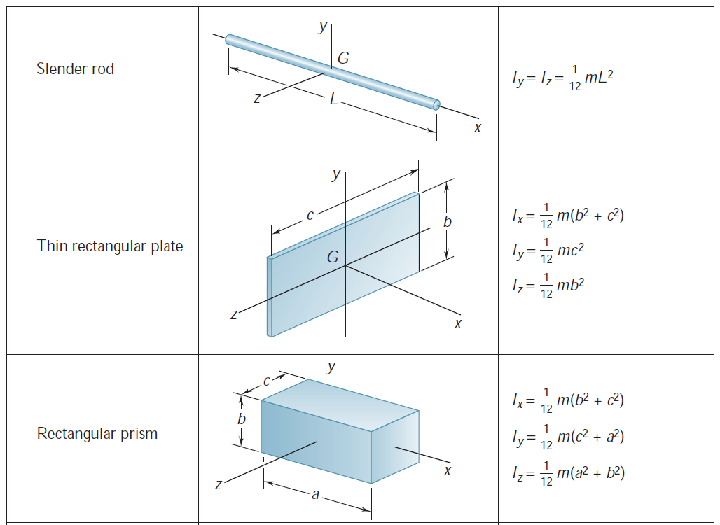
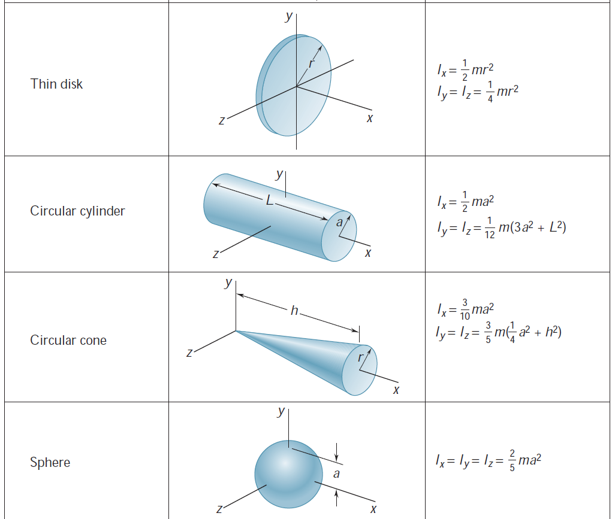
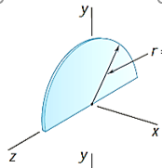

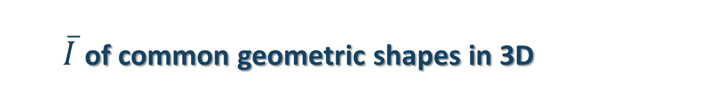
$\overline{I}$ of common geometric shapes in 3D
Q1: Why no I_{x}?
Q2: Why I_{x}=I_{y}+I_{z}?
NOTE: To understand the physics, not memorize the formulae. It is because the directions of x,y,z given in the question may not be the same as that in this table, such as Example 6, in which y is normal to the rectangular plate. Thus, I_{y}=1/12m(b²+c²)
Semicircular disk

Slide 20
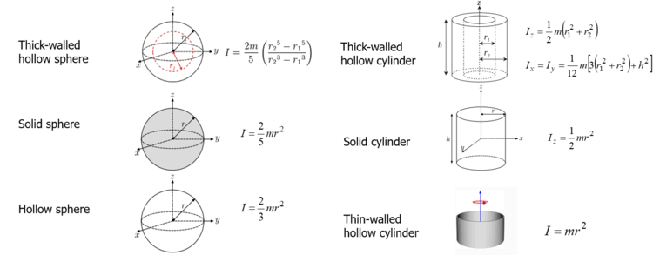
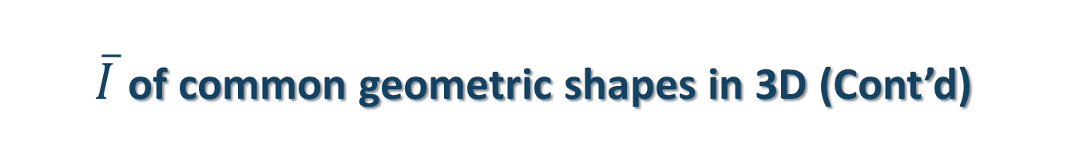
$\overline{I}$ of common geometric shapes in 3D (Cont’d)

Slide 21
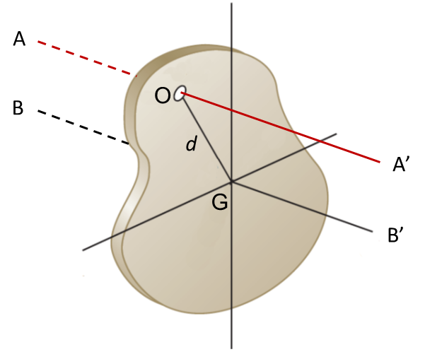
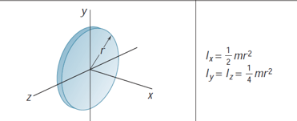



*Parallel-axis theorem & Example 5
$$I_{o}(about AA^{′})=\overline{I}(about BB^{′})+md^{2}$$
where d is the distance between O and G.
Note: AA’ must be parallel to BB’
For example, we know I_{G} of a think disk from the Table.
B’
A
o
B
G
A’
$$I_{O}\left(about AA^{′}\right)=I_{x}+md_{OG}^{2}$$
NOT equal to $I_{y}+md_{OG}^{2}$as AA’$∦$ y axis
$$I_{O}\left(about BB^{′}\right)=?$$

Slide 22



Example 5
Given ${\overline{I}}_{y}=\frac{1}{12}mL^{2}$ (Table in previous slide), find $I_{o}$
Instead of using integration in Example 4, we can apply parallel-axis theorem
L/2
O
$$d=\frac{L}{2}$$
G
$$I_{o}=\overline{I}+md^{2}=\frac{1}{12}mL^{2}+m{\left(\frac{L}{2}\right)}^{2}=\frac{1}{3}mL^{2}$$

Slide 23
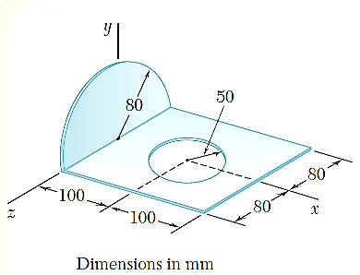
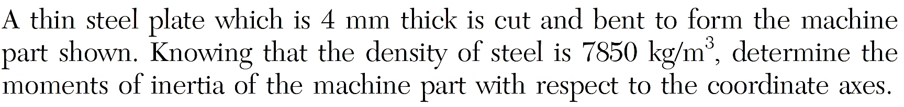
Example 6

Slide 24
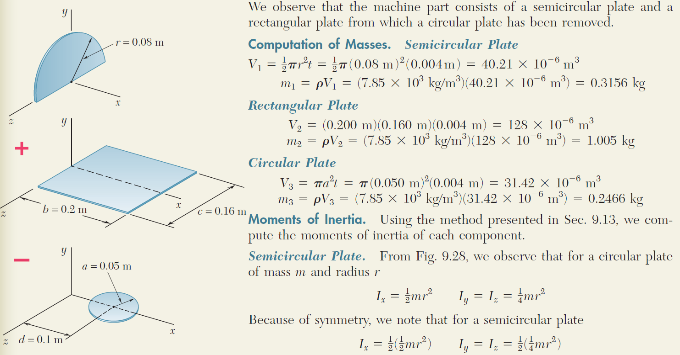
Example 6 (solution)
the formulae given in slide 19,
Note: all parts use the same coordinates.

Slide 25
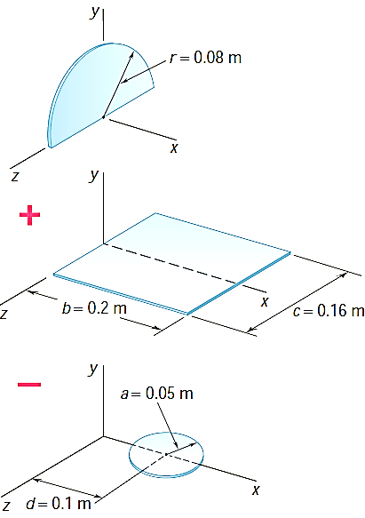
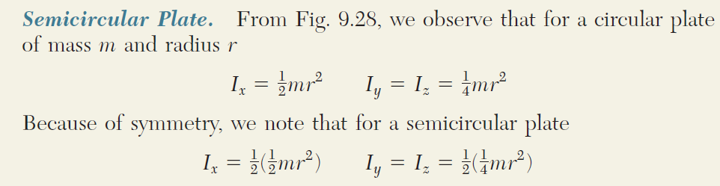
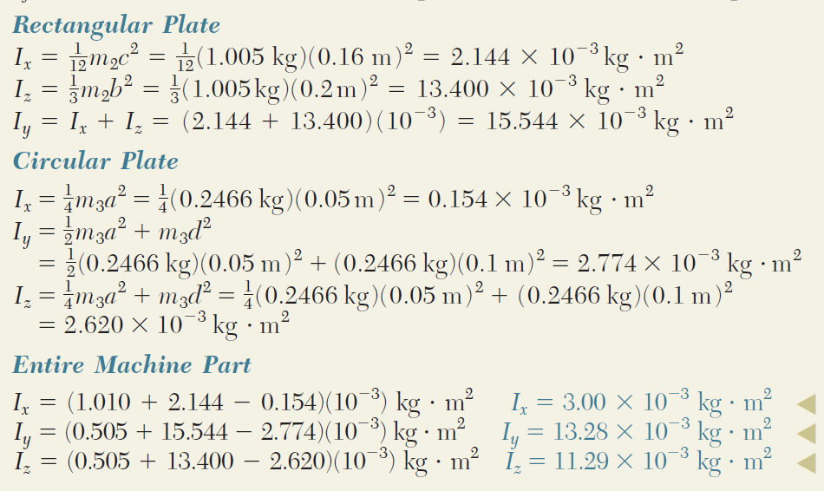

Example 6 (solution)
slide 18
From the Table in slide 19, we observe that a semicircular plate of mass m and radius r
$$I_{z}=\frac{1}{12}m_{2}b^{2}+m_{2}{\left(\frac{b}{2}\right)}^{2}$$

Slide 26
The END

